Slide 1
Crime Pattern Detection Using Geospatial and Temporal Analysis
Using Power BI and Machine Learning
Team Members
Sk.Fayaz
Sk.Shafi
B.Chakrapani
Sk.Ameesh

Slide 2
Abstract
This project analyzes crime datasets using Power BI for visualization and Python ML models for prediction. It provides insights into crime severity trends and helps in preventive measures.

Slide 3
Introduction
- Objective: Predict and analyze crime severity
- Tools: Power BI, Python, ML algorithms
- Modules: Data Collection, Preprocessing, Visualization, Prediction

Slide 4
Literature Survey
Reviewed existing studies on crime prediction using ML and BI tools.
- BI for visualization
- Regression & cluster models for prediction

Slide 5
Algorithms / Modules
- Data Cleaning
- Machine Learning Models: Decision Tree, Random Forest, Linear Regression, etc.
- Power BI Dashboards

Slide 6
System Architecture
Loading Crime Dataset
Data Preprocessing
ML Model Training
Predictions
Visualizations [Power Bi]

Slide 7
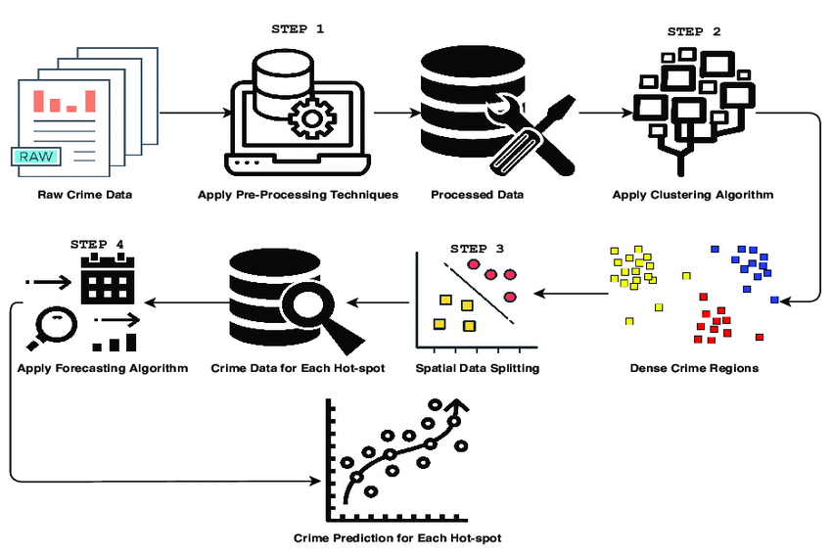
Data Flow Diagrams

Slide 8
Existing vs Proposed System
Existing: Manual reporting, limited visualization
Proposed: ML predictions, Power BI dashboards

Slide 9
Results
- Power BI dashboards (crime severity trends)
- ML model performance (R², RMSE)
- Ui Representation

Slide 10
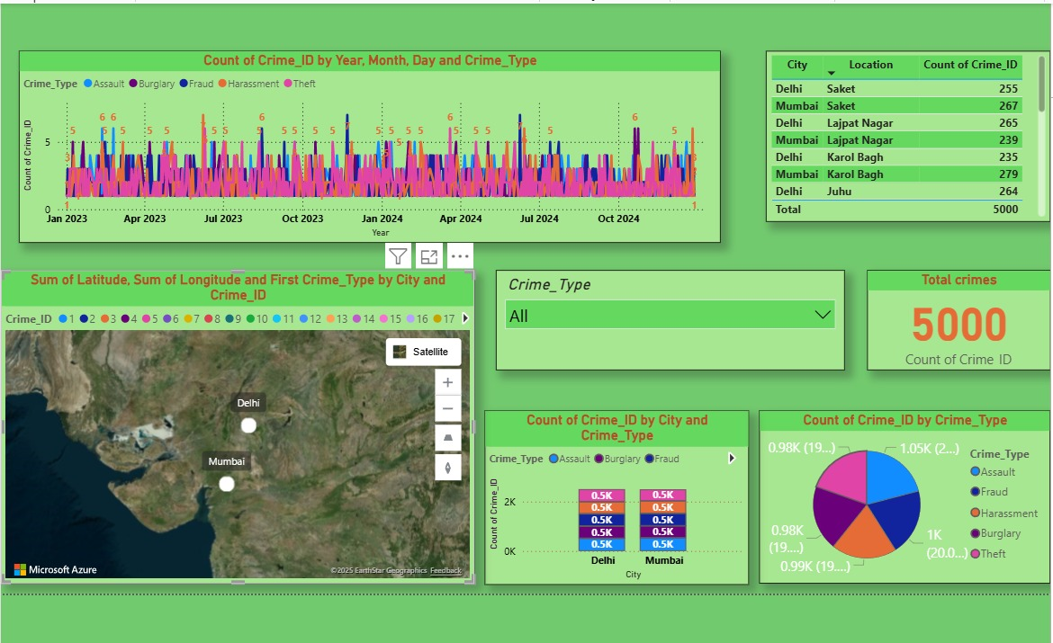
Power BI dashboards (crime severity trends)

Slide 11

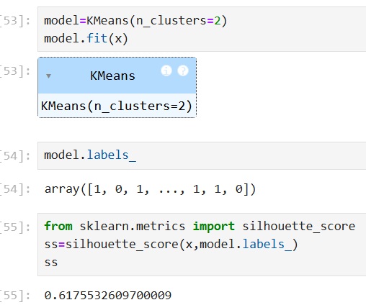
ML model performance in the regression (R², RMSE)
ML model performance in the clusters score(Kmean)

Slide 12
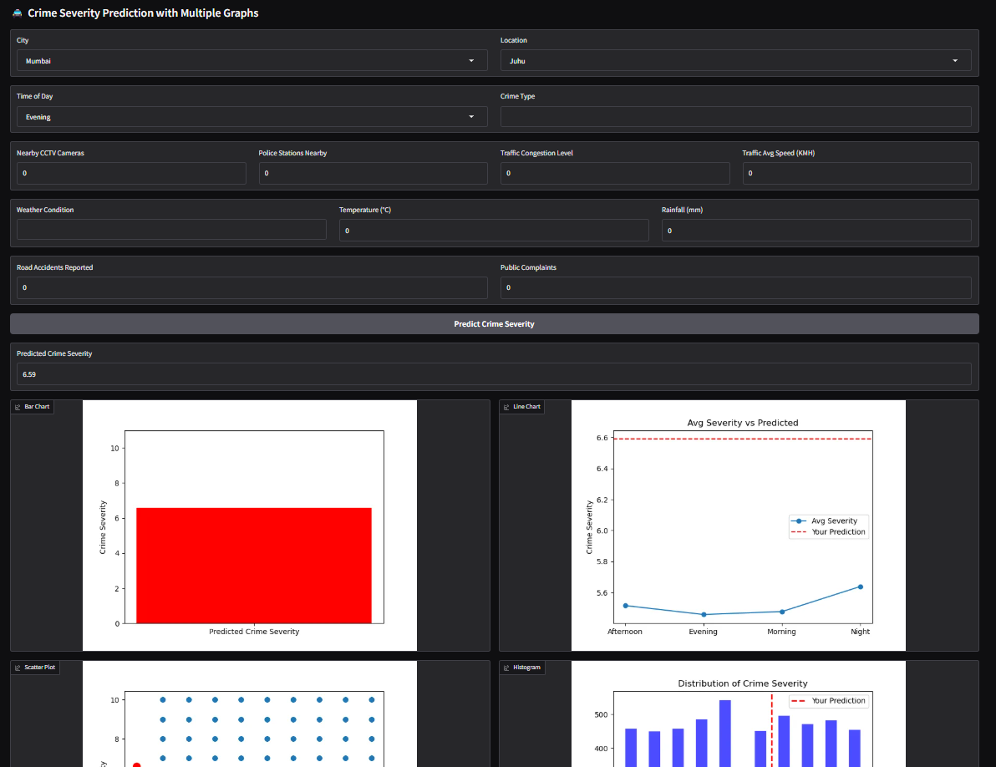
Ui Representation using gradio

Slide 13
Conclusion & Future Scope
Conclusion:
- Combined BI + ML improves crime analysis
- Provides actionable insights
- prediction rate in regression is 1.0, In cluster 0.47 to 0.61
Future Scope:
- Real-time integration
- Neural Networks
- Web-based dashboards

Slide 14
References
- IEEE / ACM research papers on crime prediction
- Power BI documentation
- scikit-learn documentation

